Slide 1

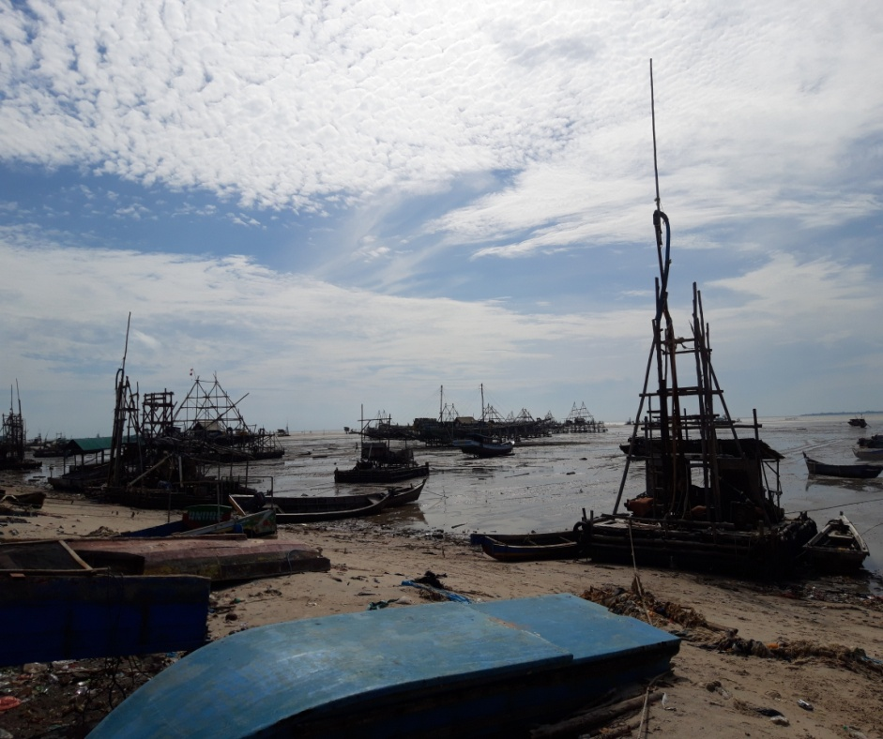
TRADITIONAL FISHERIES MANAGEMENT IN CONFLICT ZONES BASED ON THE BLUE ECONOMY CONCEPT
Endang Bidayani^{1*)}, Reniati Reniati²⁾, dan Agung Priyambada³⁾

Slide 2
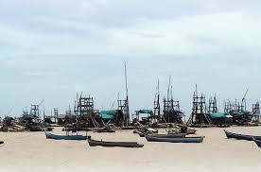
Introduction
Blue economy is an environmentally friendly management concept to ensure the sustainability of fish resources. This is considered effective in minimizing conflicts of interest in coastal areas. One of the conflict zones in the Province of the Bangka Belitung Islands is located on the coast of Kebintik Village and Batu Belubang Village, Pangkalan Baru District, Central Bangka Regency.

Slide 3
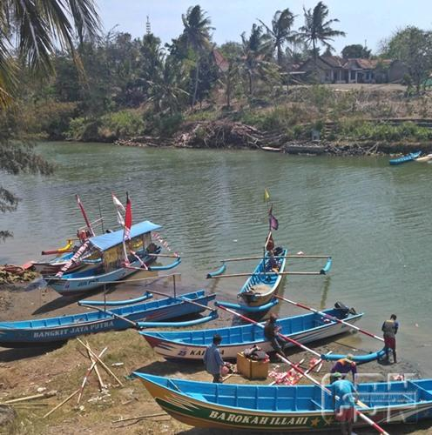
For this reason, this research will focus on: 1) Analysis of the implementation of blue economy principles; and 2) Analysis of traditional capture fisheries management in conflict zones for sustainable fish resources.

Slide 4
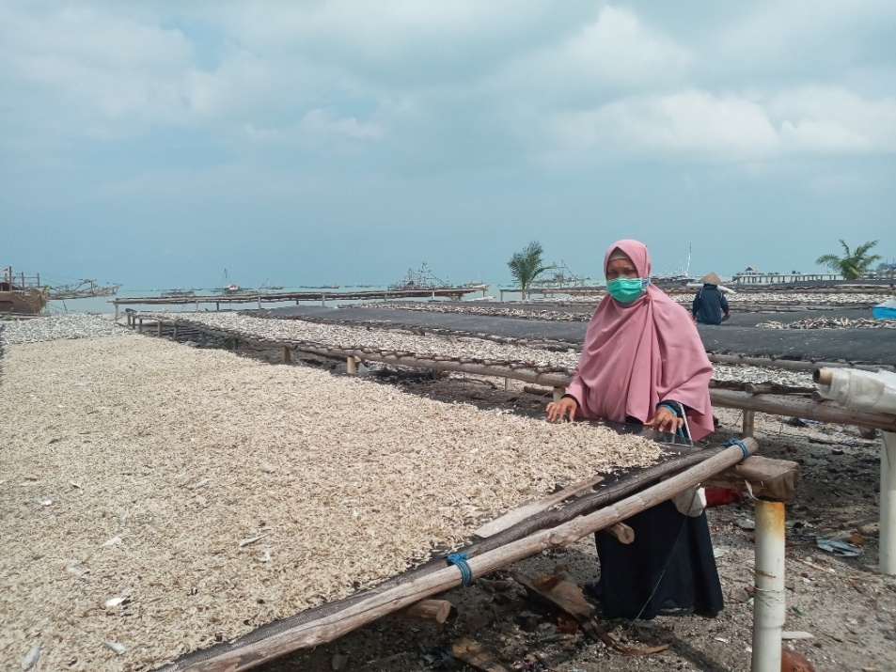
Research Method
This research method is a survey method. The research was conducted in June – July 2022. The research method was a survey. Data collection using census techniques and focus group discussions. The population in this study are traditional fishermen who have operated for more than one year in coastal areas as many as 30 people, and 30 people affected by the community. Data collection methods in this study include primary data and secondary data. Primary data collection using a questionnaire, observation and documentation. Secondary data collection through literature study. The data analysis method used is descriptive method.

Slide 5
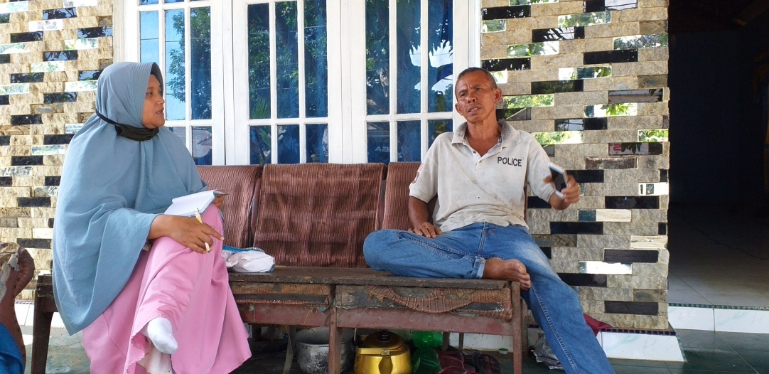
RESULT AND DISCUSSION
The blue economy principles studied include resource efficiency, zero waste, social care, production cycle systems, investment, innovation and adaptation. The fishing effort of traditional fishermen in the abundant season, all respondents (100%) are efficient. Meanwhile, in the famine season, 57% of fishermen break even (R/C = 1), 33% (R/C <1 ) are inefficient, and 10% (R/C > 1) are efficient. The results of this study are in line with the research of Nainggolan et al. (2021), that the income of traditional fishermen in the fishing season is around Rp. 65,000/day or Rp. 980,000/month. Meanwhile, in the famine season, the income of traditional fishermen is Rp. 13,000/day or 205,000/month.

Slide 6
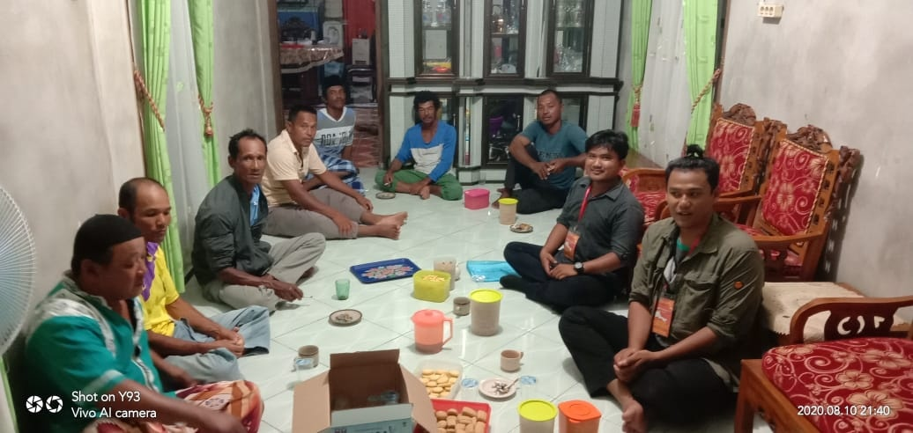
Study of the Zero Waste principle, the catch of traditional fishermen as a whole can provide economic benefits. As many as 86.67% of fishermen stated that their catch provided economic benefits (soldable), while 13.33% of fishermen stated that the fish that were not sold were usually consumed by themselves. To increase income, fishermen can process fresh fish into various kinds of processed products. This opinion is reinforced by Nainggolan et al. (2021), the government can provide fish processing training to fishermen to increase added value.

Slide 7
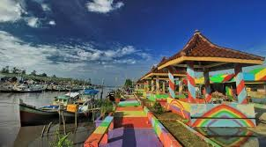
The production cycle system means that the traditional capture fisheries business can continue continuously. As many as 90% of fishermen can still carry out fishing activities by changing locations. This is reinforced by the opinion of Bidayani (2021), in conflict zones, fishermen find it difficult to get fish, so fishermen change locations.

Slide 8
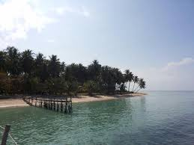
The willingness of traditional fishermen to invest in business, innovate to increase productivity and be able to adapt in conflict zones. All fishermen (100%) are willing to invest in business by increasing the number of fishing gear, and adding bait variations to increase productivity as a form of adaptation in conflict zones. According to Nainggolan et al. (2021), the government can provide financial support for the procurement of fishing facilities and infrastructure.

Slide 9
Analysis of traditional capture fisheries management in conflict zones for sustainable fish resources based on the blue economy concept includes village government policies related to activities in coastal areas, approaches used in case of conflicts of interest in coastal areas, efforts made to create peace in the community, appropriate empowerment programs to help fishermen, and stakeholder expectations for sustainable fish resources.

Slide 10
The policies of the Batu Belubang Village Government related to activities in coastal areas, especially for fishermen, include: Increasing the capacity of Human Resources, providing facilities and infrastructure such as cold storage, fishing gear assistance, counseling, good fishing training, additional facilities at Fish Auction Places, and assistance pier extension. Meanwhile, policies for tin miners include: setting up mining zones, encouraging licensed tin mining, prohibiting mining in fishing areas, and controlling illegal tin mining activities. The strategy to increase fishermen's income according to Nainggolan et al (2021), is an aggressive strategy including the formation of fishing groups and the use of modern fishing gear.

Slide 11
The approach used if there is a conflict of interest in the coastal area is deliberation. Efforts made to create peace in the community are setting operational areas, not interfering between tin miners and fishermen, and compensation from mining actors in fishing areas. According to Bidayani (2019), methods that can be used to manage conflict include compromise. Appropriate empowerment programs to assist fishermen include training and mentoring of fishermen and fish processors, as well as facilitating the needs of fishermen. Stakeholders hope that fish resources are sustainable, including setting up marine space utilization zones, using environmentally friendly fishing gear, and maintaining the cleanliness of the marine environment. According to Nainggolan (2021), the government routinely conducts outreach, training for fishermen to process fish and how to preserve sustainable marine and coastal resources.

Slide 12
Conclusion and Suggestion
The conclusions of this study are: 1) The implementation of blue economy principles includes resource efficiency, zero waste, social care, production cycle systems, investment, innovation and adaptation ranging from 86% - 100% or high category; and 2) Traditional capture fisheries management in conflict zones for sustainable fish resources is a compromise.
Suggestions from the research are: setting up marine space utilization zones, using environmentally friendly fishing gear, and fishermen empowerment programs to increase income

Slide 13
ACKNOWLEDGEMENT
The authors would like to thank the entire community and the Government of Batu Belubang Village, Pangkalan Baru District, Central Bangka Regency as research respondents, and the Research and Community Service Institute (LPPM) of the University of Bangka Belitung for funding research through the Higher Education Excellence Research grant scheme.

